Slide 1
Hotel Room
Booking Management System
www.collaberadigital.com

Slide 2
Key Takeaways/Learnings from the Program (HTD)
.Net Core MVC Web Application
.Net Core Web API with Entity Framework in ASP.NET Core Web Applications and Web API
ASP.NET CORE Identity Entity Framework Core
Application Deployment using Docker and Kubernetes

Slide 3
Project Description
The Hotel Room Booking Management System is a web-based application that streamlines the process of managing room reservations and guest information for hotels. The system provides customers with the ability to book available rooms while providing hotel staff with efficient tools to manage reservations and room inventory. Additionally, the system includes user authentication and profile management for users

Slide 4
Problem Statement of the Capstone Project
Rapid growth in the number of customers seeking accommodation services
Existing manual system is becoming inefficient, cumbersome, and time-consuming
Lots of errors, double bookings, and customer dissatisfaction
Need for a web-based hotel room booking application
Provides a reliable and user-friendly platform for customers
Enables easy and efficient searching, booking, and managing of hotel reservations for the hotel staffs

Slide 5
Approach Note
(How the candidate approached the program)
Starting from developing of the system, we start by creating Business Requirements Documentation to support the systems functionality and requirements.
Usage of Drawi.io for creating the Entity Relationship Diagram and Wireframe of the application
Development of the application using ASP.Net Core MVC
Development of Web API
Deployment of the Application using Docker and Kubernets

Slide 6
Acceptance Criteria
User authentication using JWT tokens
Multiple user roles with appropriate dashboards
Room management including adding, updating, and deleting rooms and setting room details
Booking management with availability checking and room booking
User management including adding, updating, and deleting users and assigning user roles
Profile management allowing users to update their information
Error handling and security to protect user data
Performance and scalability to handle high volumes of requests
Thorough testing to ensure functionality and meet acceptance criteria

Slide 7
Project Scope
User Management: login/logout, change password, manage profiles
Admin Dashboard: manipulate room availability, user credentials, room categories, bookings
Guest Dashboard: see all available rooms, book available room
Room Management: add, update, delete rooms from inventory
Booking Management: book a room, provide personal and payment information

Slide 8
Out Of Scope
Invoice for processing payments and Integrating with external third-party tools for managing payments like Gcash, Maya Wallet, Paypal, etc.
Max occupancy for every rooms
Book rooms base on selected location and date of stay
Email Verification of the booking which will serve as virtual receipt

Slide 9
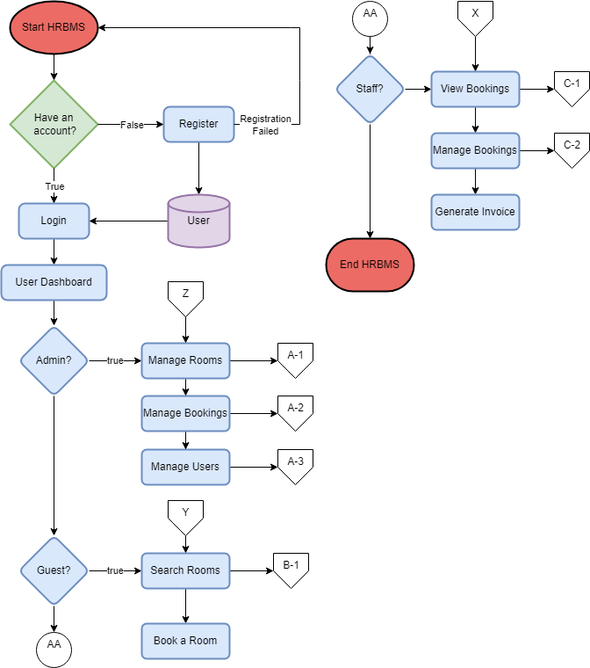
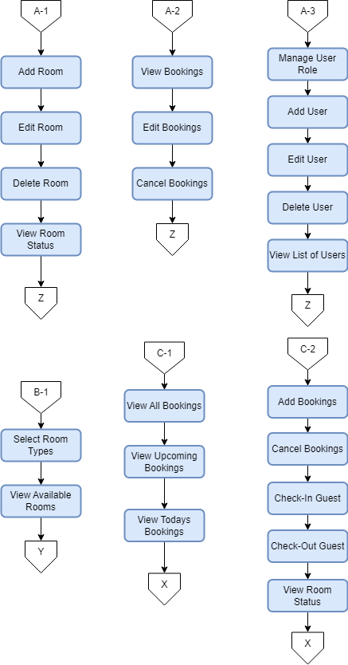
FlowChart

Slide 10
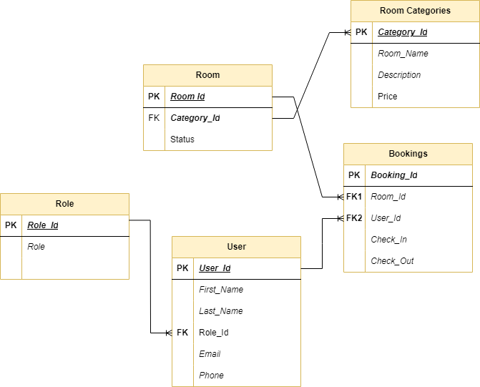
Entity-Relationship Diagram

Slide 11
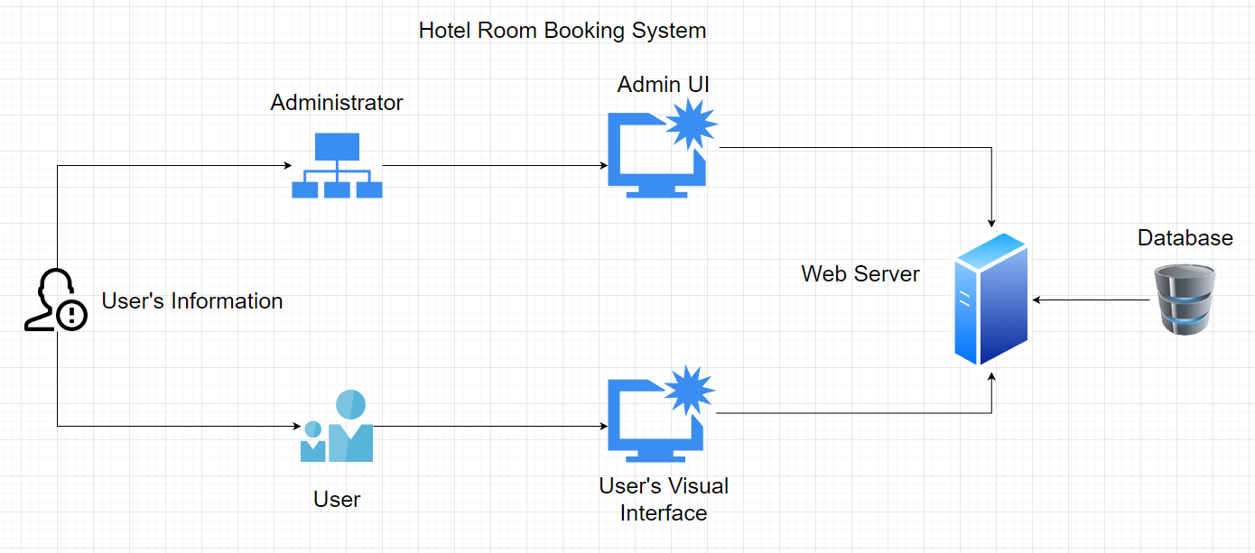
System Architecture

Slide 12


Important areas of the Project with screenshots
(Frontend, Database, Backend, Key Validations, Functionalities Etc.)
Login, Register View
Dashboard for User (Guest View)
Booking
Change Password
Dashboard for Admin
Available Rooms (crud)
Room Types or Categories
Modifying Users (crud)
Booking
Rooms
www.collaberadigital.com

Slide 13
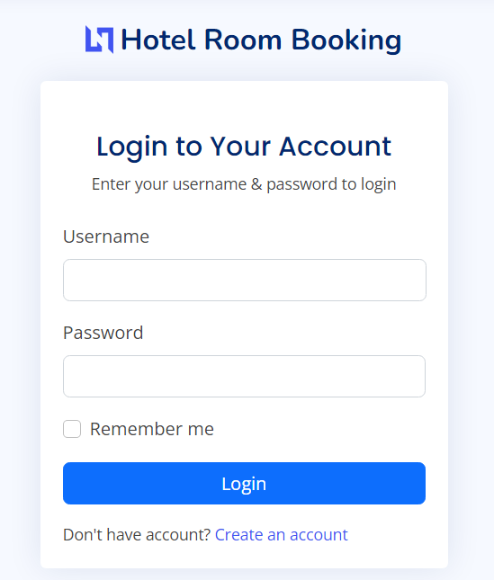
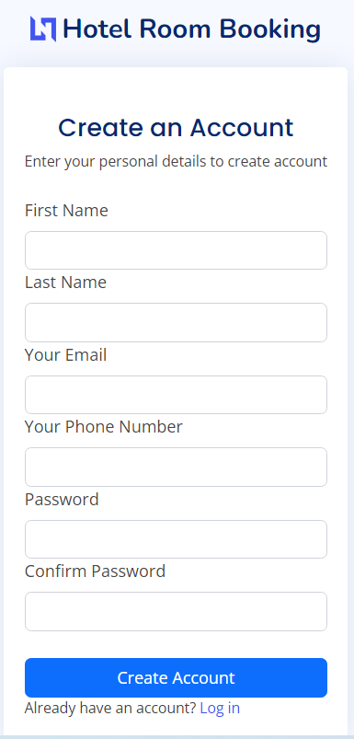
Important areas of the Project with screenshots
(Frontend, Database, Backend, Key Validations, Functionalities Etc.)

Slide 14
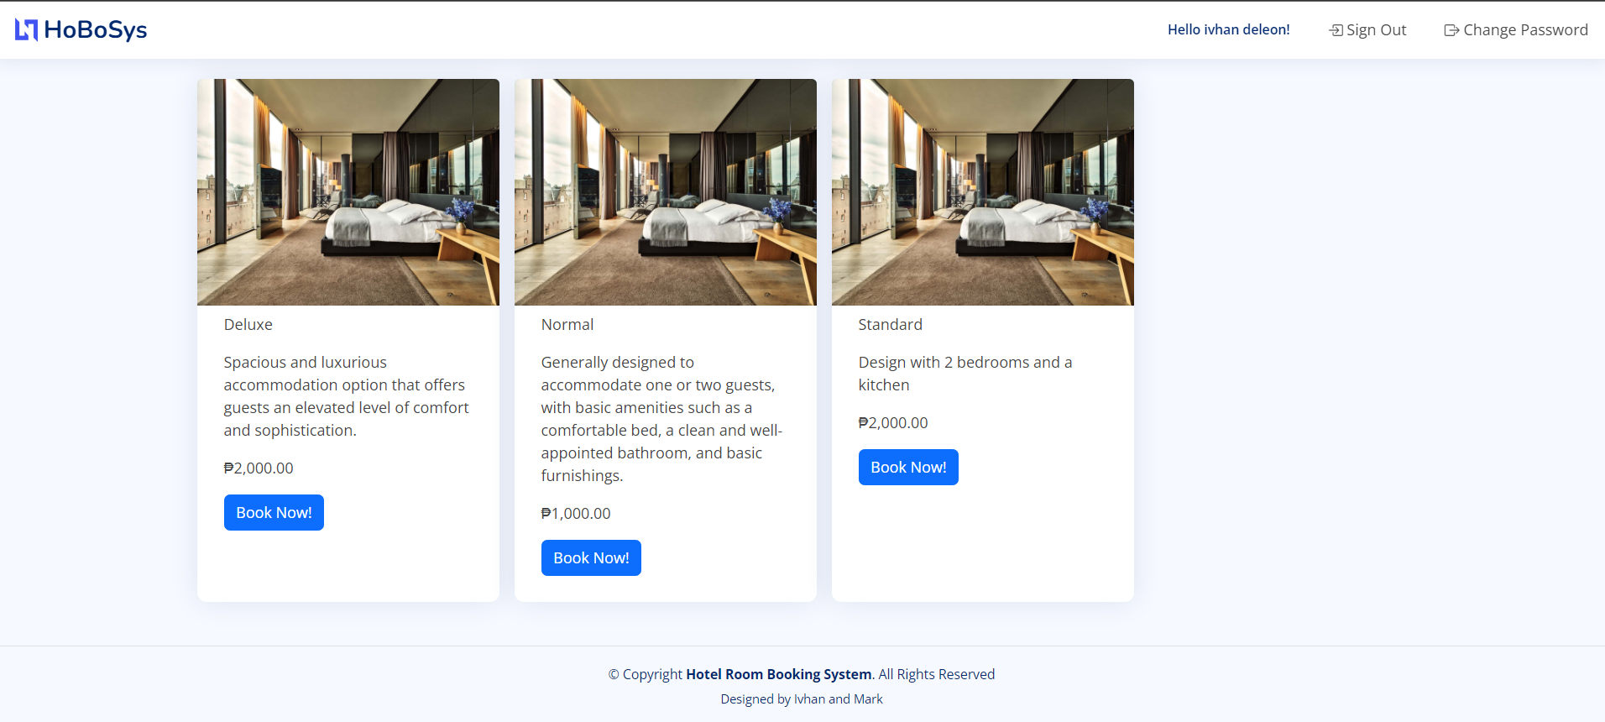
Important areas of the Project with screenshots
(Frontend, Database, Backend, Key Validations, Functionalities Etc.)

Slide 15
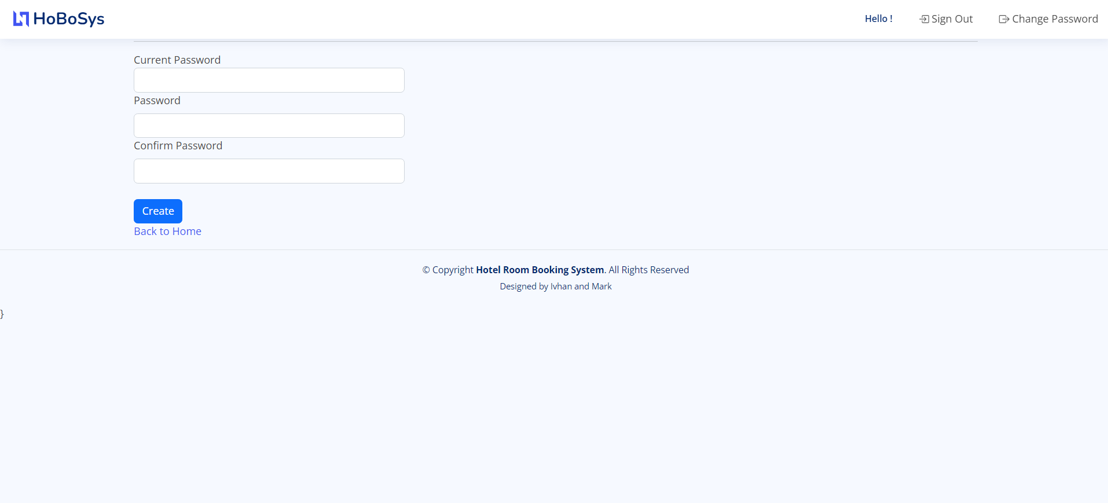
Important areas of the Project with screenshots
(Frontend, Database, Backend, Key Validations, Functionalities Etc.)

Slide 16
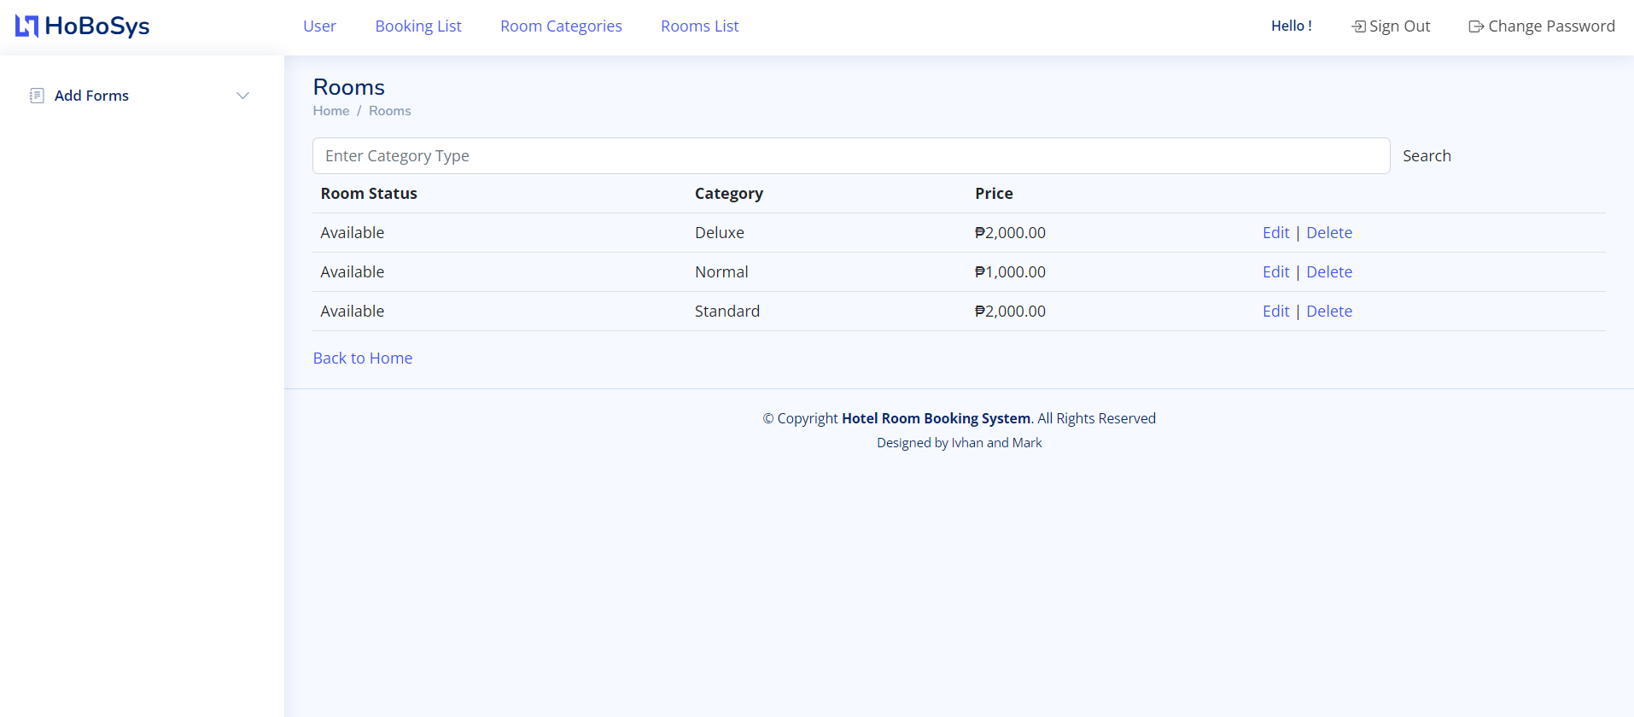
Important areas of the Project with screenshots
(Frontend, Database, Backend, Key Validations, Functionalities Etc.)

Slide 17
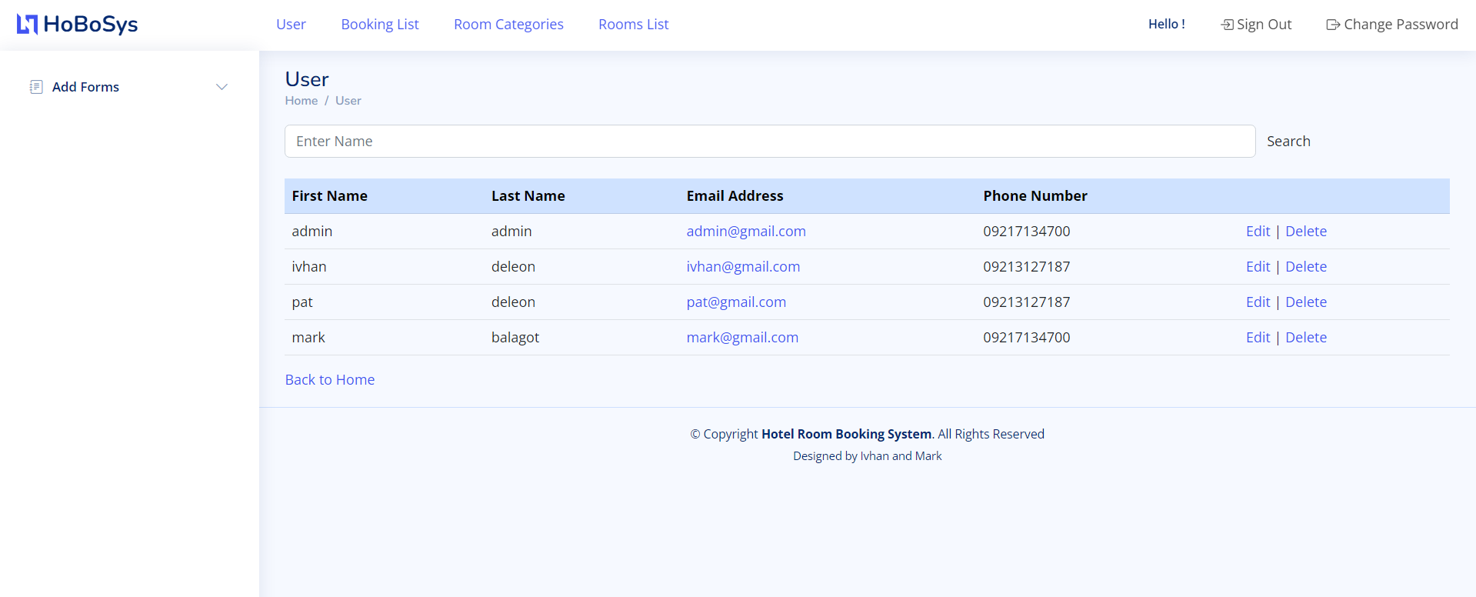
Important areas of the Project with screenshots
(Frontend, Database, Backend, Key Validations, Functionalities Etc.)

Slide 18
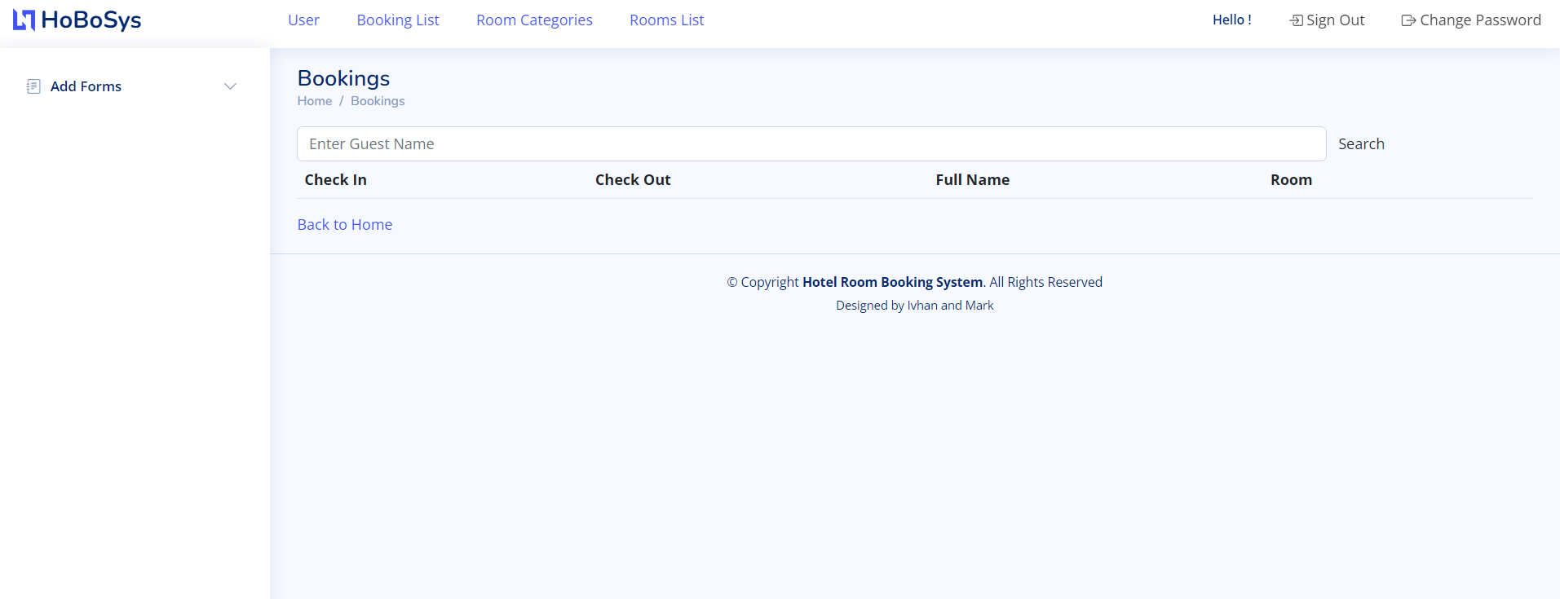
Important areas of the Project with screenshots
(Frontend, Database, Backend, Key Validations, Functionalities Etc.)

Slide 19
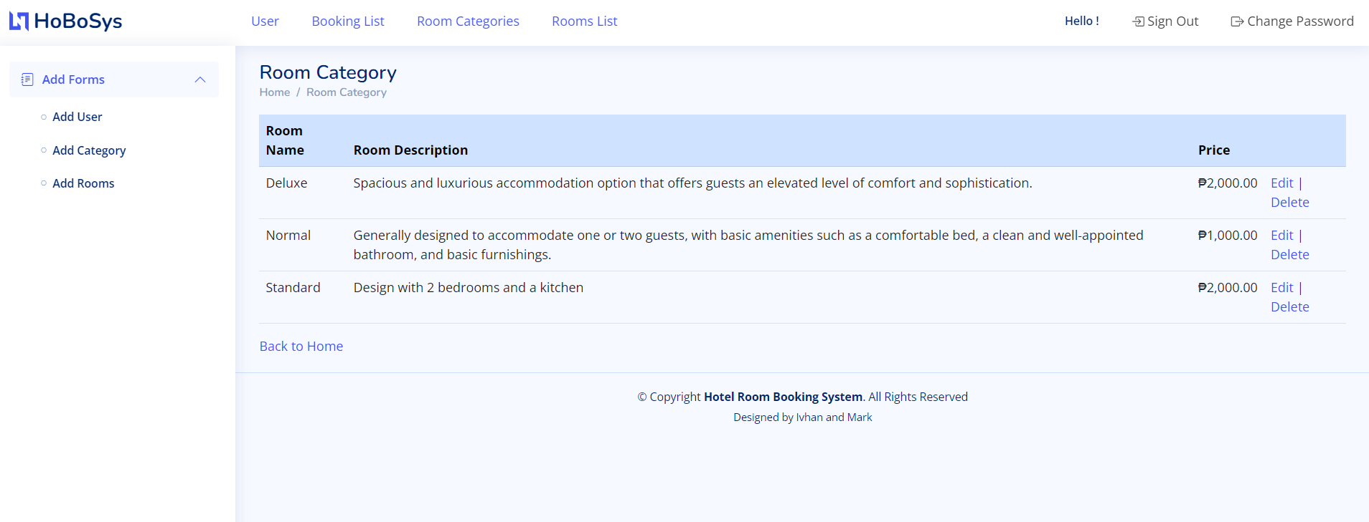
Important areas of the Project with screenshots
(Frontend, Database, Backend, Key Validations, Functionalities Etc.)

Slide 20
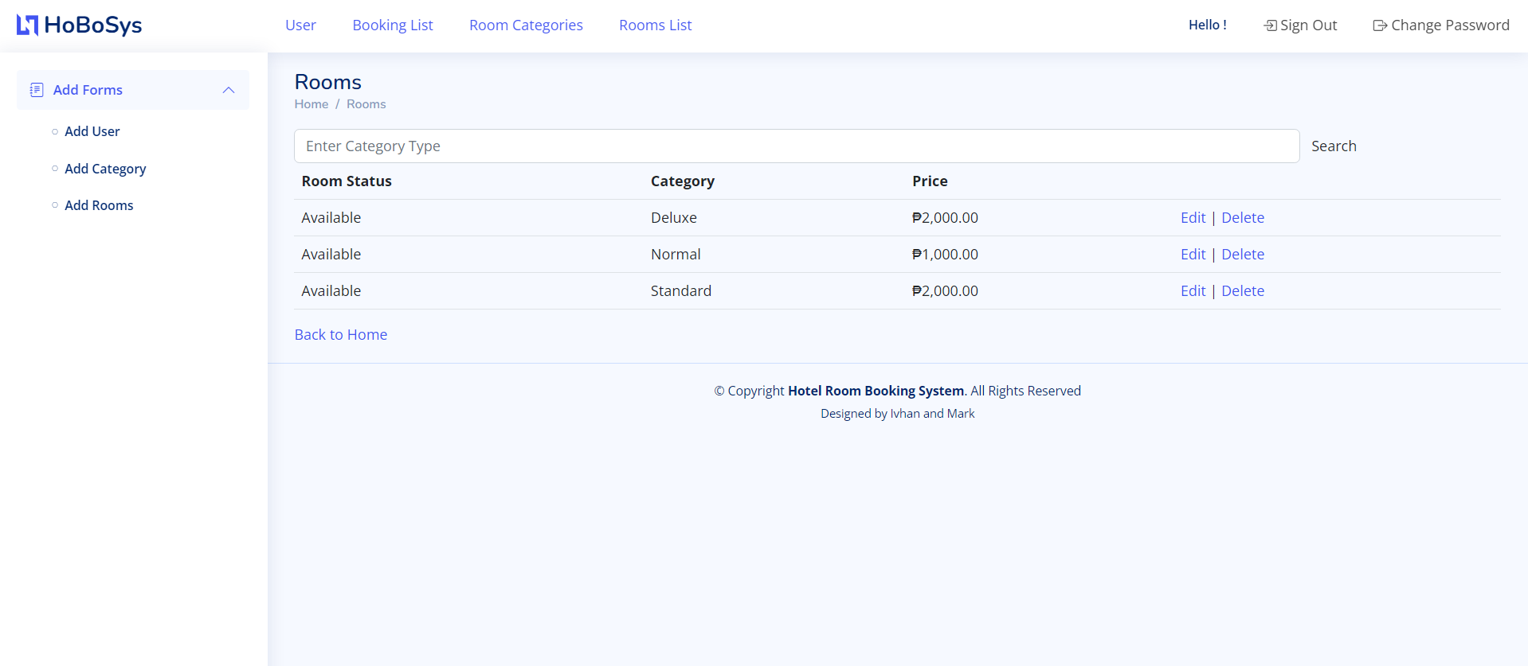
Important areas of the Project with screenshots
(Frontend, Database, Backend, Key Validations, Functionalities Etc.)

Slide 21
Conclusion
The Hotel Room Booking Management System is an efficient and effective tool for managing hotel room reservations, guest information. It provides a range of features to help hotel staff manage guest bookings and improve the overall guest experience. With its robust security measures, the system ensures that user data is protected at all times.

Slide 22
Thank You
www.collaberadigital.com

